Slide 1
Spark Streaming
What is Spark Streaming ?
Need for Streaming and its Analytics
Brief overview on Spark.
Why Spark streaming is being adopted rapidly?
Architecture (Traditional Vs Spark Streaming)
Advantages/Goals
Working
Sources /Operations.
Demo using an example.

Slide 2
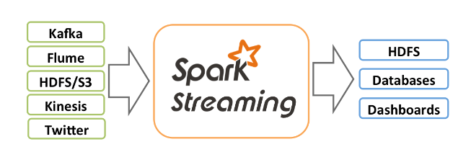
Spark Streaming
Spark Streaming was added to Apache Spark in 2013, an extension of the core Spark API.
Spark Streaming is an extension of the core Spark API that enables scalable, high-throughput, fault-tolerant stream processing of live data streams.
Data can be ingested from many sources like Kafka, Flume, HDFS, Kinesis etc.,

Slide 3
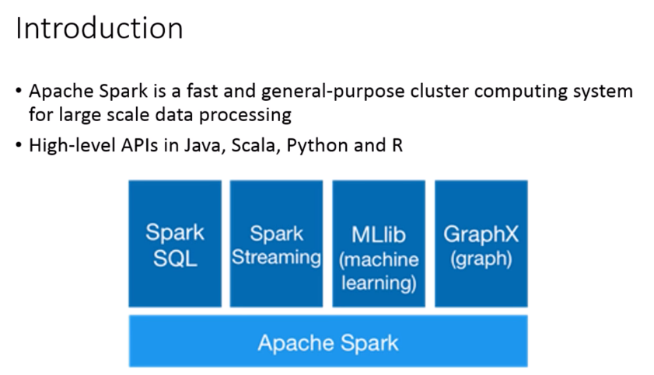
Apache Spark

Slide 4
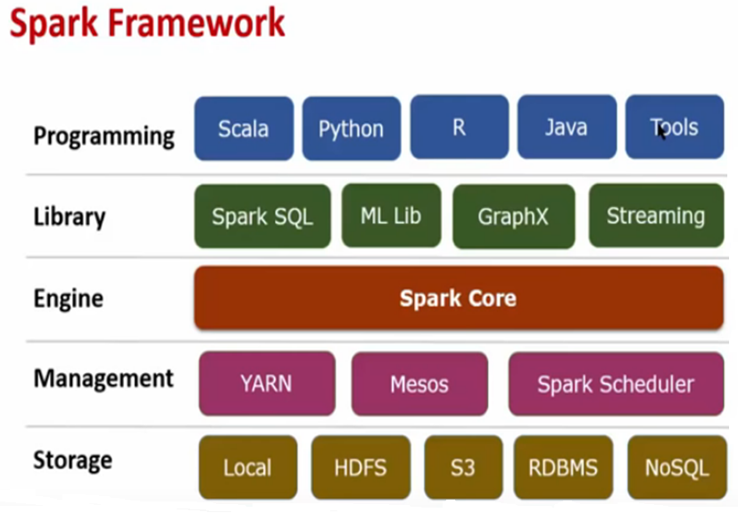
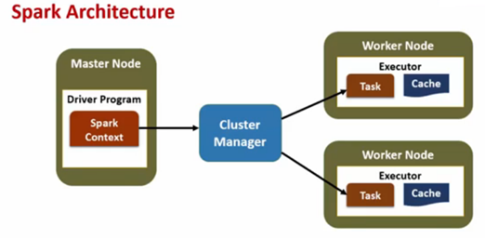

Slide 5
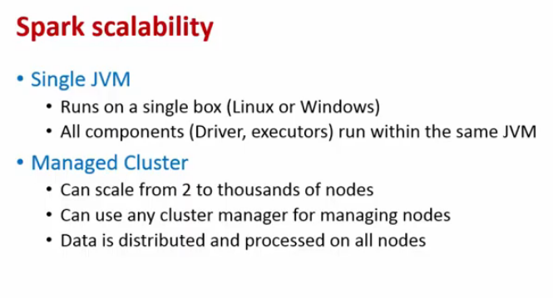
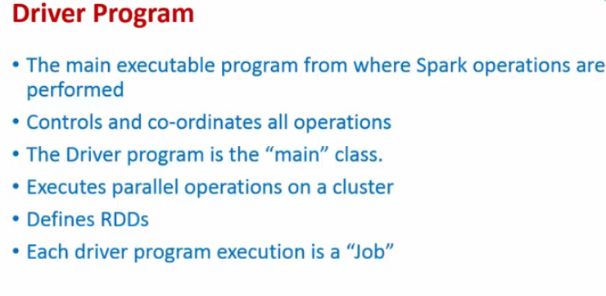

Slide 6
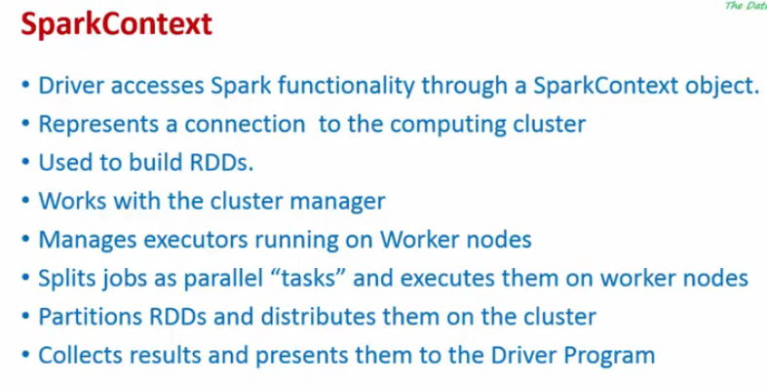

Slide 7
Spark modes
Batch mode
A program is scheduled for execution through the scheduler, runs fully at periodic intervals.
Interactive mode
An interactive shell is used by the user to execute spark commands one-by-one.
This shell acts as the driver program and provides Spark Context.
Can run tasks on cluster.
Streaming mode
A program that runs continuously and processes data as it arrives.

Slide 8
Need for Streaming Analytics
Sensors
IoT devices
Social Networks
Online Transactions.
All of these are generating data that needs to be monitored constantly and acted upon quickly.
As a result, the need for large scale, real-time stream processing is more evident than ever before.

Slide 9
Need for processing pipeline that caters not only the real-time aspect, but also the associated pre-processing and post-processing aspects.
Before Spark Streaming, building complex pipelines that encompass streaming, batch, or even machine learning capabilities with open source software meant dealing with multiple frameworks
There was a huge cost of managing multiple frameworks in production. Spark and Spark Streaming, with its unified programming model and processing engine, makes all of this very simple.

Slide 10
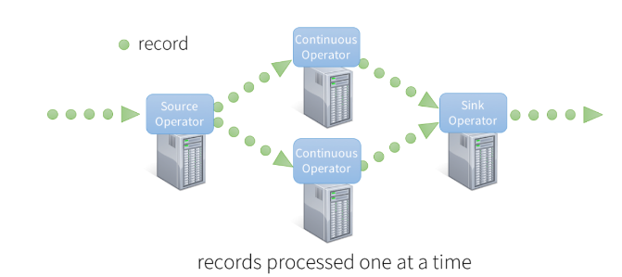
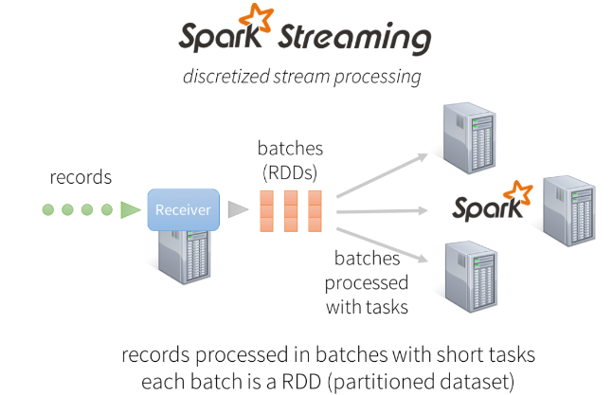
Traditional Stream processing systems

Slide 11
Why Spark Streaming is being adopted rapidly?
Ease of Use : Spark Streaming brings Spark’s language-integrated
API to stream processing letting users write in Java , Python , Scala.
Single framework for all the processing needs.
Spark ML Library availability within the framework.
Developers and system administrators can spend less time learning, implementing, and maintaining different frameworks, and focus on developing smarter applications.
Can combine static and streaming resources.

Slide 12
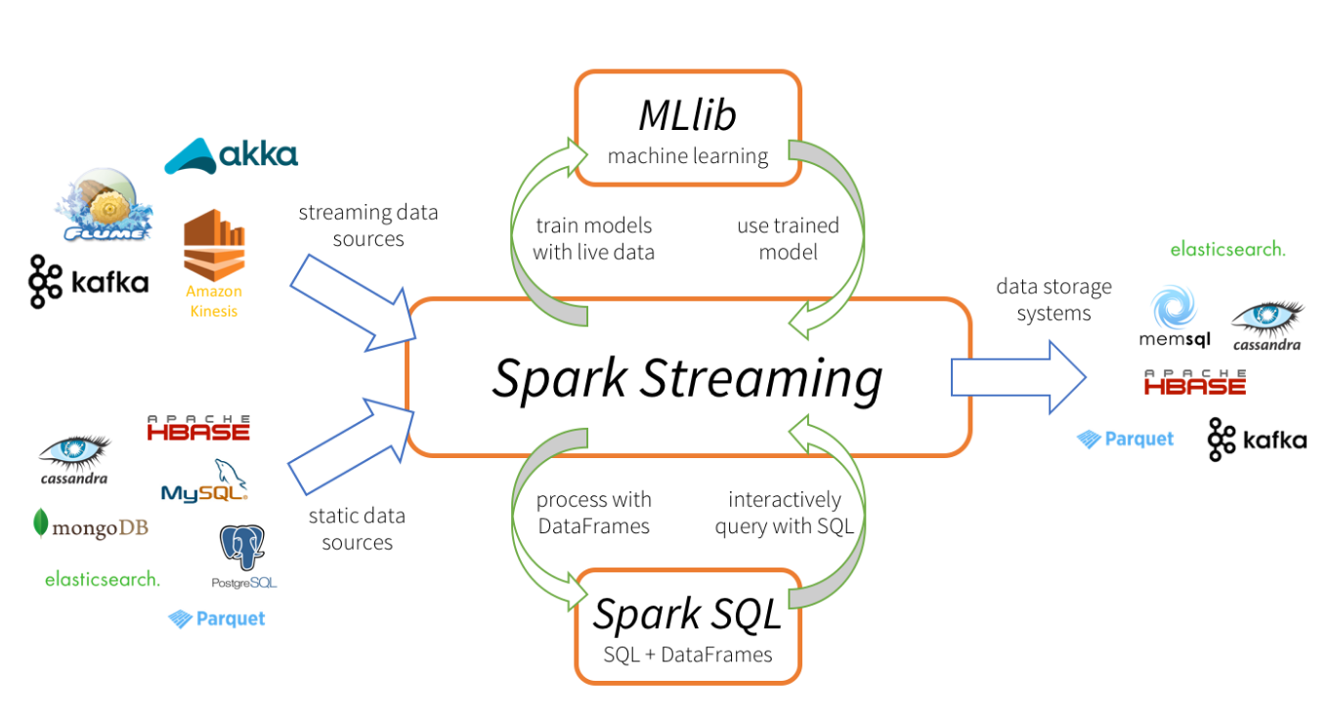
Spark Streaming- Sources and sink (Streaming data and Static data)

Slide 13
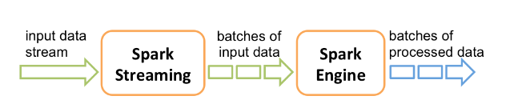
Spark Streaming receives live input data streams and divides the data into batches, which are then processed by the Spark engine to generate the final stream of results in batches.

Slide 14
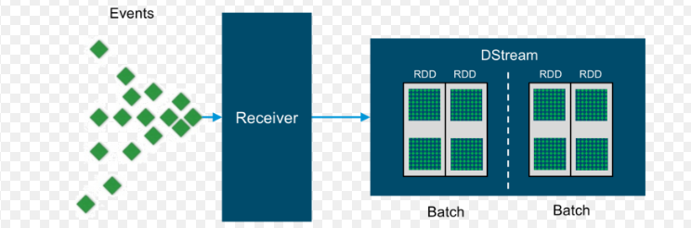
Discretized Streams (DStreams)
DStream is the basic abstraction provided by Spark Streaming.
It represents a continuous stream of data, either the input data stream received from source, or the processed data stream generated by transforming the input stream.
Internally, a DStream is represented by a continuous series of RDDs.

Slide 15
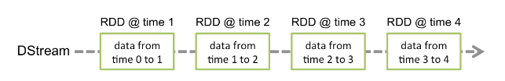
Each RDD in a DStream contains data from a certain interval.

Slide 16
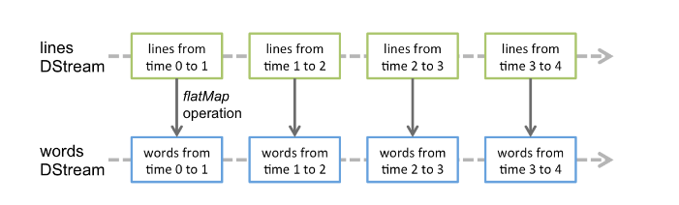
DStreams support the following operations:
map countByValue
flatMap filter
count reduce
reduceByKey join
updateStateByKey
Any operation applied on a DStream translates to operations on the underlying RDDs.
For example , converting a stream of lines to words, the flatMap operation is applied on each RDD in the lines DStream to generate the RDDs of the words DStream.

Slide 17
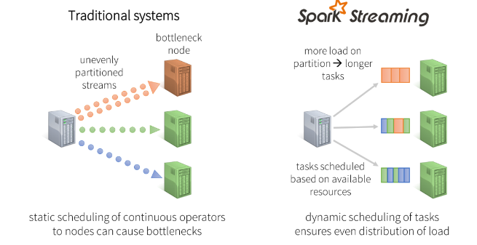
Benefits of Discretized Stream Processing Dynamic load balancing

Slide 18
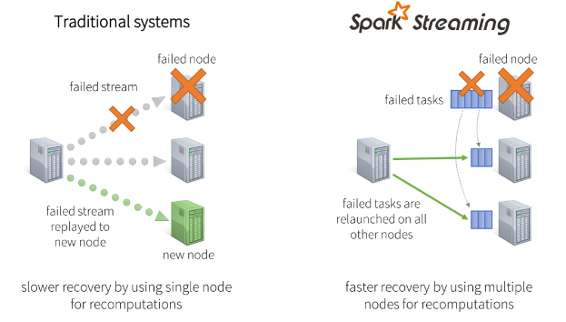
Fast failure and straggler recovery

